Slide 1

Computer Science
Does a body good

Slide 2

Discourses and Dialogs on Debugging
Perry Kivolowitz
Professor of Computer Science
Carthage College

Slide 3
Summary
Megan and Fredo wrote buggy code.
Megan paid attention to this talk, found her problems quickly and went out dancing.
Fredo is still slamming Red Bulls.
Fredo can’t feel his lips.
Don’t be like Fredo.

Slide 4
The thesis of this talk is:
debugging is based in science
(science can be taught)

Slide 5
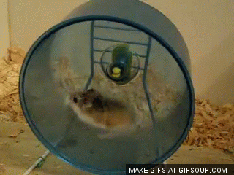
Most Common Debugging Algorithm
Program doesn’t work
Make a change
Does program work?
Notes:
This is the most common debugging algorithm among (beginning) CS students. Perhaps this is your technique. Not for long.

Slide 6
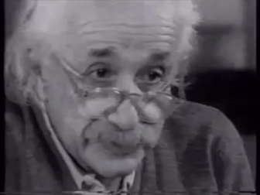
The Scientific Method
Observe /
Gather Data
Formulate hypothesis
Test hypothesis
Albert sez: Debugging should be methodical

Slide 7
Kivolowitz Corollary
“A fix is not a fix until you completely understand why it’s a fix”
Notes:
If you cannot explain why a fix is a fix, then you have not formulated (and not tested) a hypothesis. If you rubbed your chin and the bug went away would you be satisfied? Hope not.

Slide 8
Kivolowitz Maxim #1
If you make a change with no beneficial result, back it out*
Else, you are chasing a moving target
*unless you are certain you’re fixing a different bug
Notes:
* Have you ever looked at your code and said “How could this ever have worked?”

Slide 9
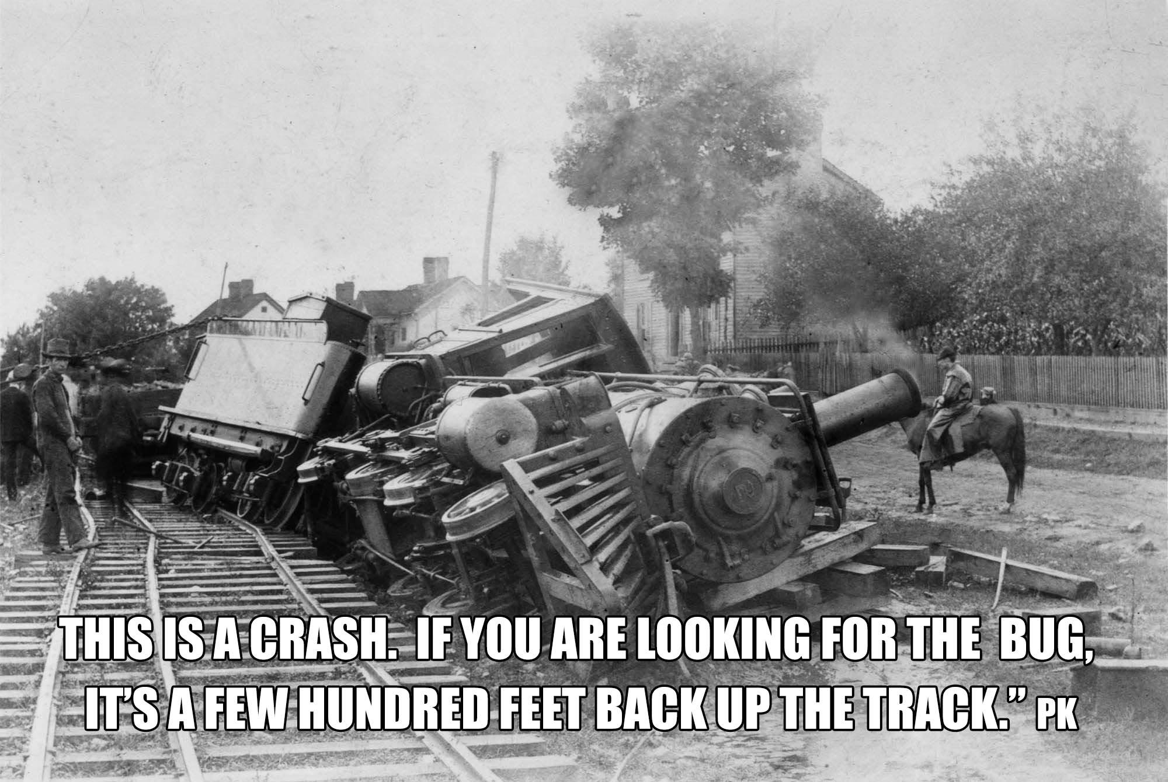
Maxwell (Mickey) Cohen’s Law
“Where there is one, there are many”
Notes:
Maxwell Cohen was talking about surf clams, but his words are equally applicable to bugs.
What you see may be the locomotive buried in the ground, smoldering. That’s awful. But it’s the end of a series of unfortunate events. Some time in the past, the wheels started leaving the tracks.

Slide 10
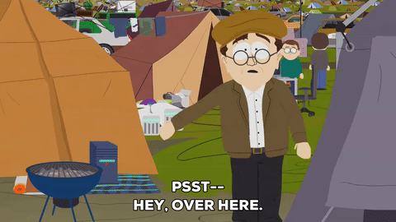
Kivolowitz’s Maxim #2
Bugs want to be found
if you make the effort to listen
Observe /
Gather Data
Formulate hypothesis
Test hypothesis

Slide 11
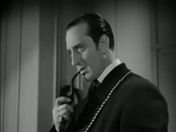
Conan Doyle’s Law
“When you have eliminated the impossible, whatever remains, however improbable, must be the truth.”
The Sign of Four, 1890

Slide 12
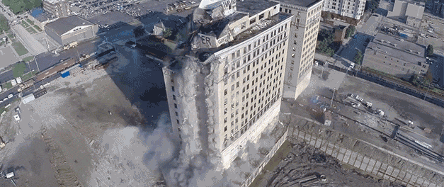
Kivolowitz Maxim #3
“Write in small units.
Test in small units.”
Notes:
Sometimes I retest after changing / adding a single line.

Slide 13

Kivolowitz Maxim #4
“Always play defense”
Extra work is finite.
Debugging time…

Slide 14

Part 2 - Dialogs (all actually happened)
http://images6.fanpop.com/image/photos/33100000/Kung-Fu-Panda-3-random-33170400-1920-810.jpg
Notes:
Every dialog presented here happened.

Slide 15
Kivolowitz Corollary Example
Student: My code crashed. I added a print out. Now it doesn’t crash. It’s fixed right?
No understanding of the “fix”

Slide 16

Kivolowitz’s Maxim #2 Example
Student: So, I have this error.
Master: What does the error say?
Student: I didn’t read it. I just
clicked “OK”
“Bugs want to be found”
They often announce themselves clearly if you make the effort to listen

Slide 17

Kivolowitz’s Maxim #2 Example
Student: My code crashes.
Master: You get compiler warnings.
Student: They’re just warnings.
“Bugs want to be found”
They often announce themselves clearly if you make the effort to listen

Slide 18

Kivolowitz’s Maxim #2 Example
Student: It crashes after running for a while.
Master: Do you have a memory leak?
Student: No, I already went.
“Bugs want to be found”
Use leak detection tools.
Leave code running for ____ if warranted

Slide 19

Kivolowitz’s Maxim #2 Example
Student: After a while my program stops responding.
Master: Do you have any infinite loops?
Student: No, I use “whiles.”
“Bugs want to be found”
Not responding? Check CPU utilization.
In a loop first code to write is how it exits.

Slide 20

Kivolowitz’s Maxim #2 Example
Student: My code works great except
on this input.
Master: Try single-stepping with just
that.
Student: Single… what?
“Bugs want to be found”
Your environment should be your friend.
Get to know it – USE IT!

Slide 21

Conan Doyle’s Law
Student: I looked everywhere for my bug.
Master: Did you look here?
Student: No. It can’t possibly be there.
“When you have eliminated the impossible, whatever remains, however improbable, must be the truth.”

Slide 22

Defensive programming and Doyle’s Law
Student: I looked everywhere for
my bug.
Master: Did you look here?
Student: No. It can’t possibly be
there.
If you “know” a condition to be true, assert() it!
Stops a cascade in its tracks
Checks the impossible and identifies the improbable

Slide 23
Cohen’s Law, Defensive programming and Doyle’s Law
#include <assert.h>
assert(condition I know to be true);
assert enforces “contracts”

Slide 24

Kivolowitz Maxim #3 Example
Student: My program worked yesterday. I wrote 5000 lines of code last night. It doesn’t work anymore.
Why?
Write in small units.
Test in small units.

Slide 25

Maxim #4 - Defensive programming example
Student: I commented like you told me.
// Increment i
Comment your thinking.
Not your code.

Slide 26

Maxim #4 - Defensive programming example
Student: I commented like you told me.
// Increment i
When commenting, think of the next person to read your code.
It might be you.

Slide 27

Maxim #4 - Defensive programming example
Student: My code doesn’t work.
Master: And there is no way it ever
would. Did you test it before
you wrote it?
Student: Wait… What?
Write the comments before your code

Slide 28

Maxim #4 - Defensive programming example
Student: My code doesn’t work.
Master: What does ineedsleep
do?
Student: I don’t remember.
I was tired.
descriptive_variable_names_really_help
Keystrokes are finite. Debugging time isn’t.

Slide 29

Maxim #4 - Defensive programming example
Student: ____; ____; ____; ____;
Master: What’s that in the middle?
Student: Where?
Newlines are free. Resist temptation for multiple statements on one line.

Slide 30
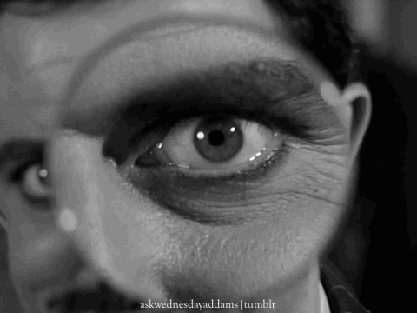
Maxim #4 - Defensive programming example
Student: __ += __ ? (__ = --__ , __) : __ = __;
Master: What’s that in the middle?
Student: Where?
Use side effects with caution
Optimizers laugh at your lame attempts to be cool.
Your coworkers just get annoyed.

Slide 31

Defensive programming and Doyle’s Law
Student: The bug can’t be here. I pasted this code.
Master: Really?
That’s different from this.
Student: Oh yeeaahhhh. I fixed a bug.
Code abstraction is actually a defensive technique
Code in one place, test in one place, fix in one place

Slide 32
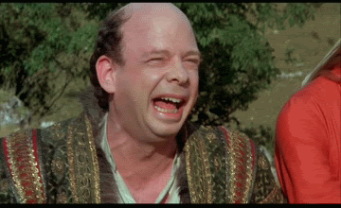
Defensive programming and Doyle’s Law
Student: foo has to be one of these
values.
Master: And if it isn’t?
Student: That’s not possible.
Always code the “default” case
Always code the “impossible else”
(tell Ben Liblit’s story)

Slide 33
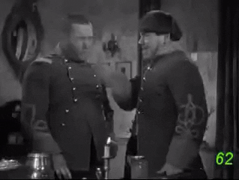
Maxim #4 - Defensive programming example
Student: My code doesn’t work.
Master: You’re not checking that
return value
Student: That has a return value?
Return values are meant to be checked

Slide 34

Importance of checking return values
Need go no further than su*
Runs setuid to root
-rwsr-xr-x 1 root root 36936 Jan 26 2016 su
Suppose it was coded like this:
setuid(uid);
execlp(argv[2], argv[2], NULL);
*Thank you Bart Miller

Slide 35
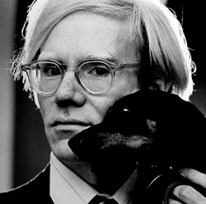
Maxim #4 - Defensive programming
“Dying is the most embarrassing thing that can ever happen to you, because someone's got to take care of all your details.”
Andy Warhol - "The Life and Death of Andy Warhol" by Victor Bockris
Lesson for programmers:
Take care of all your OWN details and die gracefully.

Slide 36

One last dialog
Student: I crash every time I get here.
Master: That’s GREAT!
Student:

Slide 37
Learn your craft - Take pride in your work
Debugging is part of the process
Grow your craft
Take pride in your work
Code like it means the difference between life and death - it may
Notes:
* Have you ever looked at your code and said “How could this ever have worked?”

Slide 38
Bottom line
Your memory leak disabled the brakes on the self driving car doing 70
Your dangling pointer brought down 911 service in a major city
Notes:
* Have you ever looked at your code and said “How could this ever have worked?”

Slide 39
Bottom line
Your “off by one” killed that grandpa with your pacemaker implanted
Your null dereference brought down that airliner. Everyone died
Notes:
* Have you ever looked at your code and said “How could this ever have worked?”

Slide 40
Kivolowitz Maxim #3 - Role of testing
Testing can only prove the presence of bugs, not their absence.
Edsger W. Dijkstra
Beware of bugs in the above code; I have
only proved it correct, not tried it.
Donald Knuth

Slide 41
Maxim #4 - Defensive programming example
Student: I wrote my own ________.
Master: Why didn’t you use _____ or STL?
Student: I wanted to write my own.
A framework vetted by thousands of programmers is probably better than yours

Slide 42
Maxim #4 and Scientific Method
Student: My code doesn’t work.
Master: Did you try ____?
Student: I don’t remember.
Comment what didn’t work so you don’t try it again.
Scientific method learns from history. Preserve it.

Slide 43
Some say debugging cannot be taught
“Debugging is an art!”
“Either you get it or you don’t!”

Slide 44
Kivolowitz’s Maxim #2 Example
Student: I get “Seg fault. Core dumped.” Can you help me?
Master: What do you think the problem is?
Student: How should I know? That’s all it says.
“Bugs want to be found”
They often announce themselves clearly if you make the effort to listen

Slide 45
Maxim #4 - Defensive programming example
Student: My code doesn’t work.
Master: You’re not checking for errors.
Student: That makes my code look ugly.
Use exceptions (when performance requirements allow)

Slide 46
Kivolowitz’s Maxim #2 Example
Student: It’s like this code isn’t even executed!
Master: Are you certain it is?
Student: Ummmmm. No.
“Bugs want to be found”
They often announce themselves clearly if you make the effort to listen

